Slide 1
CLIMATE KNOWLEDGE HUNT HACKATHON
#SemanticClimate
26-27th February 2024
Team : CLIMATE CHANGE CROP CREW
Members: Swasti, Mrityunjay, Mittali, Dr. Abhilasha

Slide 2
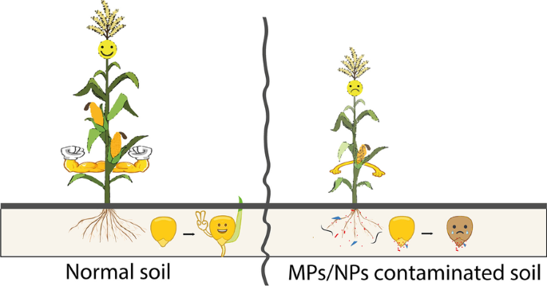
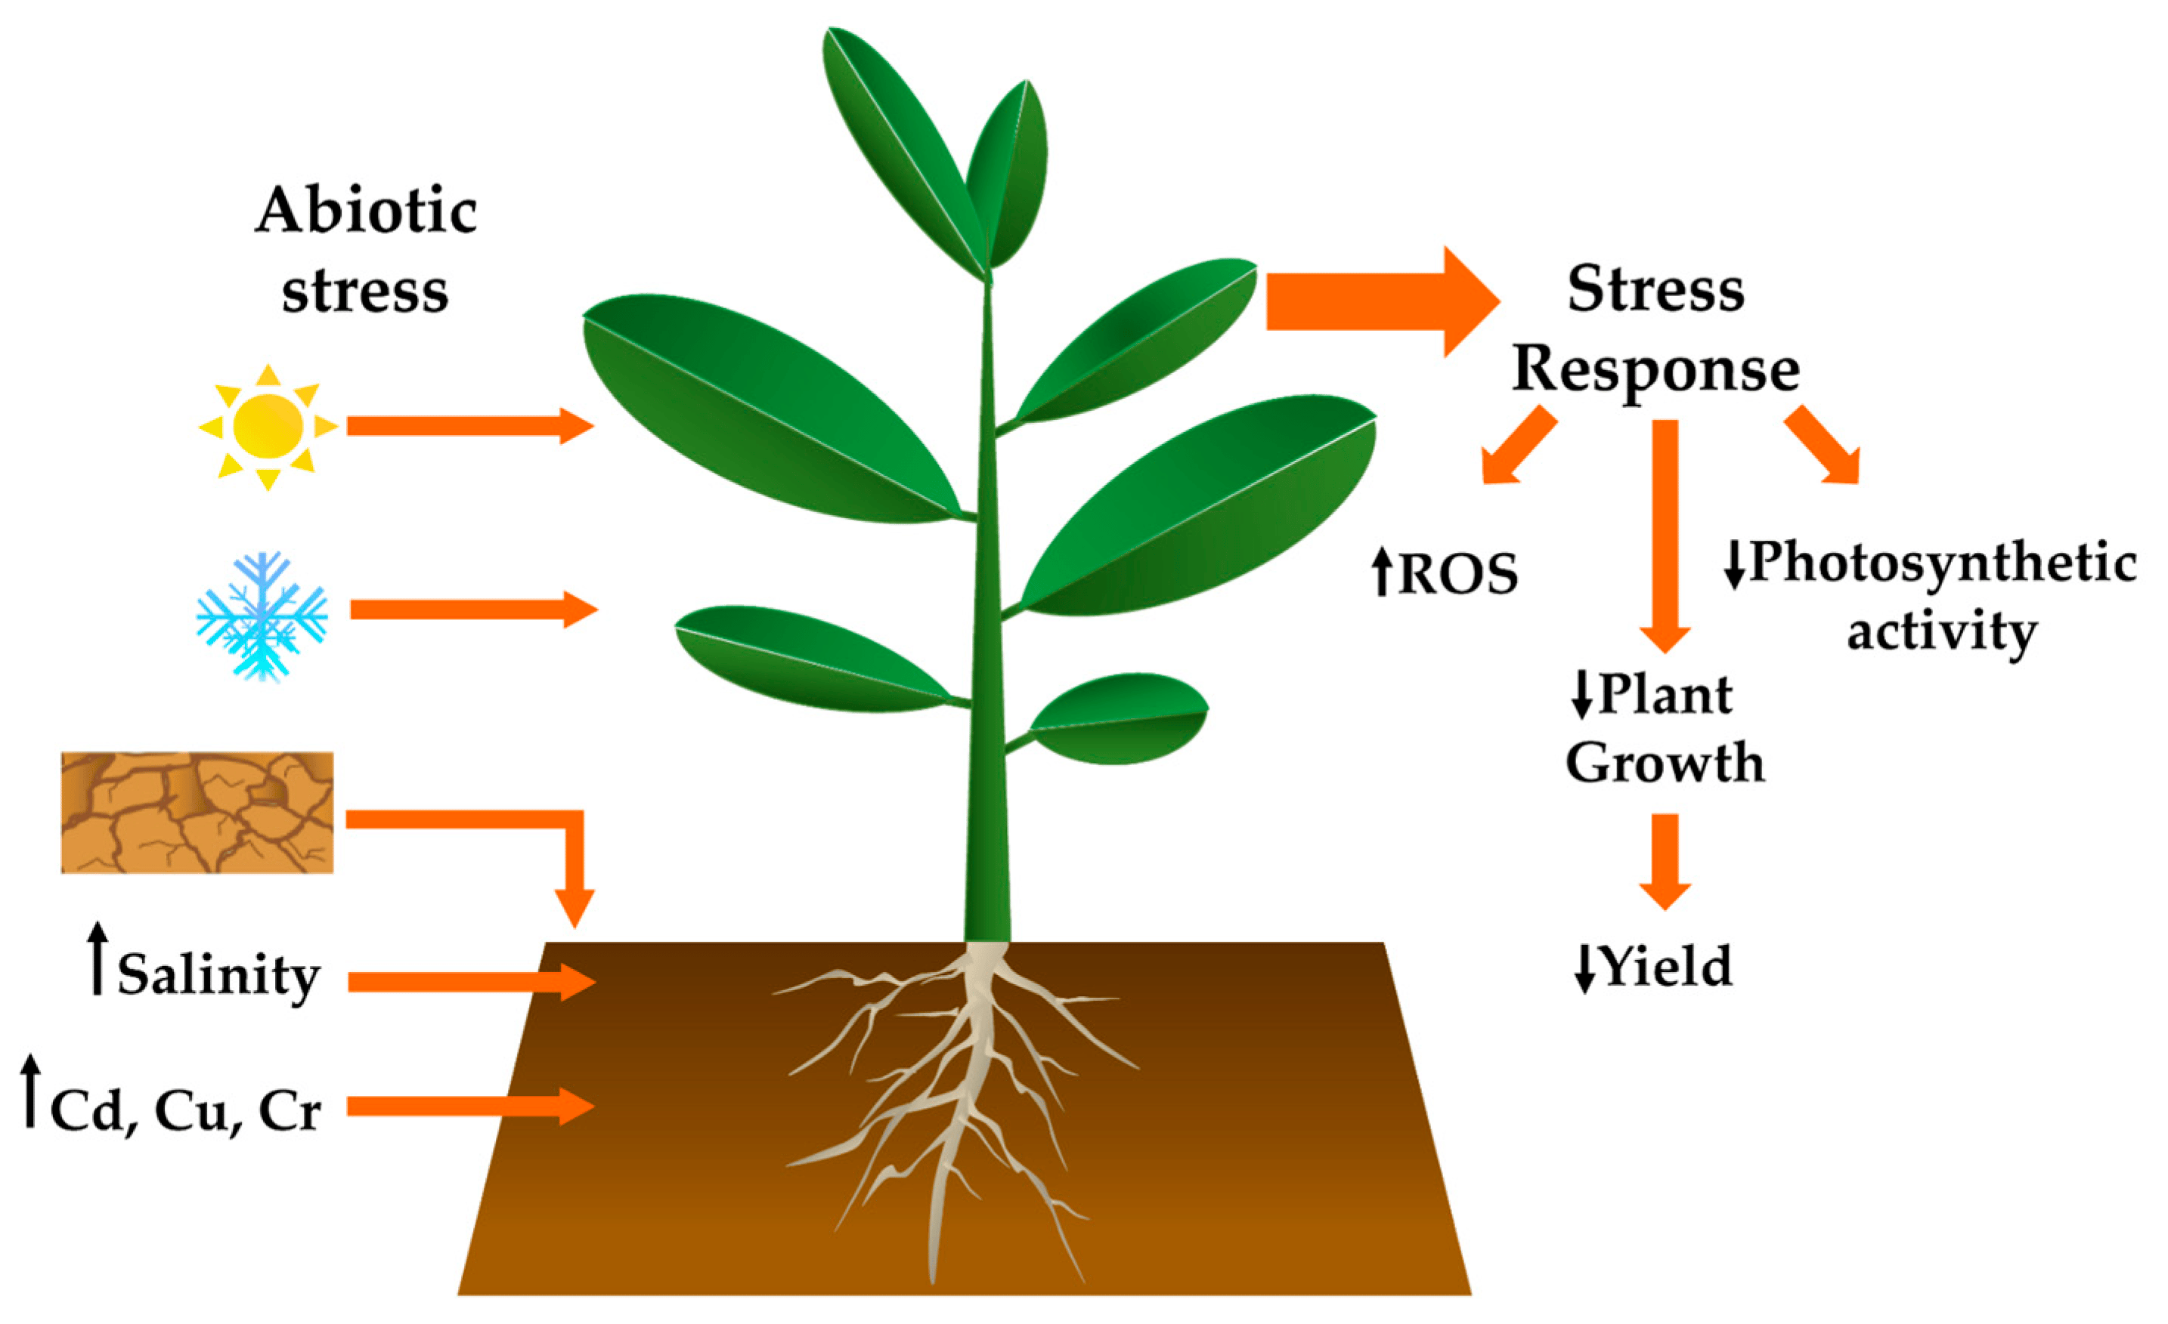
TITLE
Integrating Stress-Tolerant Crops and AI/ML Technologies for Sustainable Management of Plastic Pollution in Agricultural Systems

Slide 3
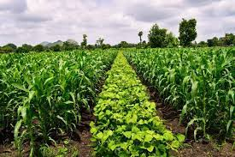
"In the face of climate change, stress-resistant crops are not just an option; they are a necessity for securing our global food supply."

Slide 4
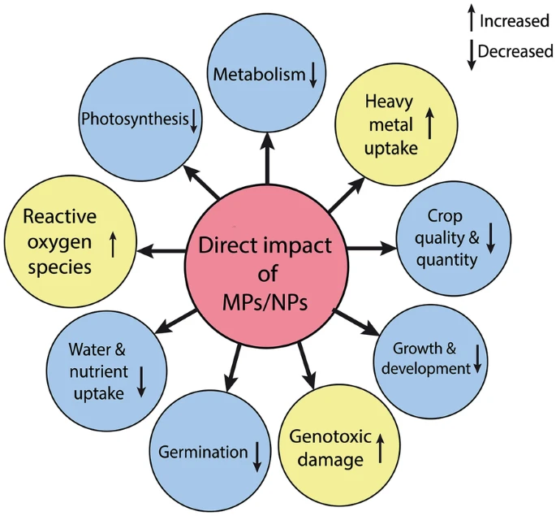

Slide 5
PROBLEM STATEMENT
Plastic and microplastic pollution pose significant threats to agricultural systems
compromising soil health
crop productivity
food security.
Even with the development of crop types resistant to stress and sophisticated technologies such as machine learning and artificial intelligence, there is still a gap in the effective mitigation of the negative effects of plastic pollution on agricultural sustainability.

Slide 6
METHODOLOGY
WE USED THE FOLLOWING TOOLS :
PYGETPAPERS
DOCANALYSIS

Slide 7
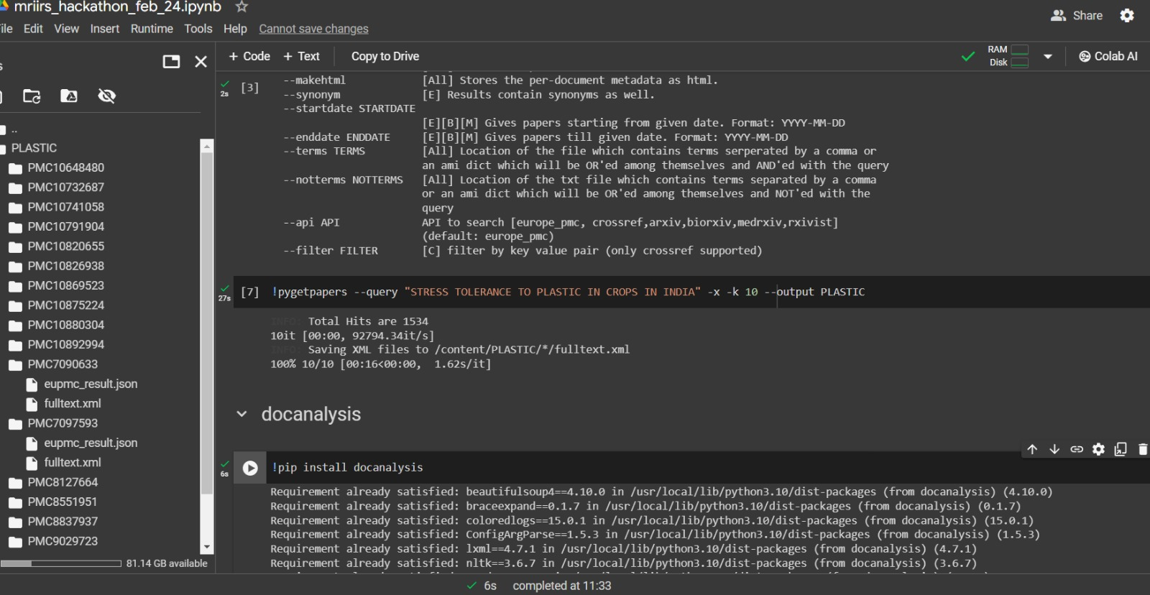
EXTRACTING PAPERS

Slide 8
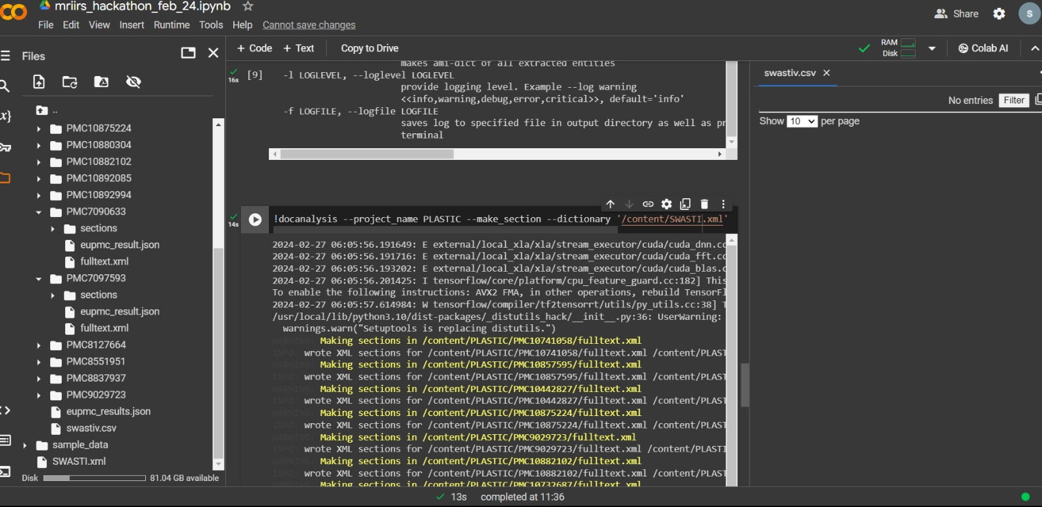
DOC ANALYSIS

Slide 9
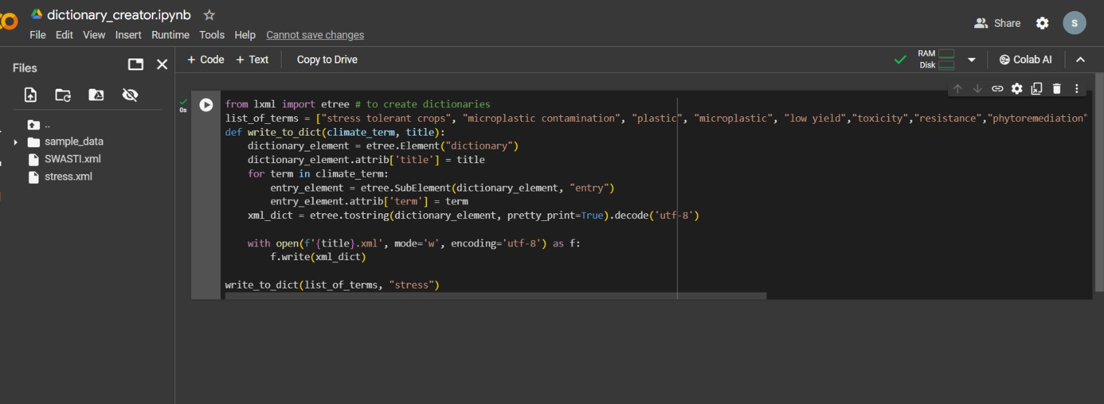
CREATING DICTIONARIES

Slide 10
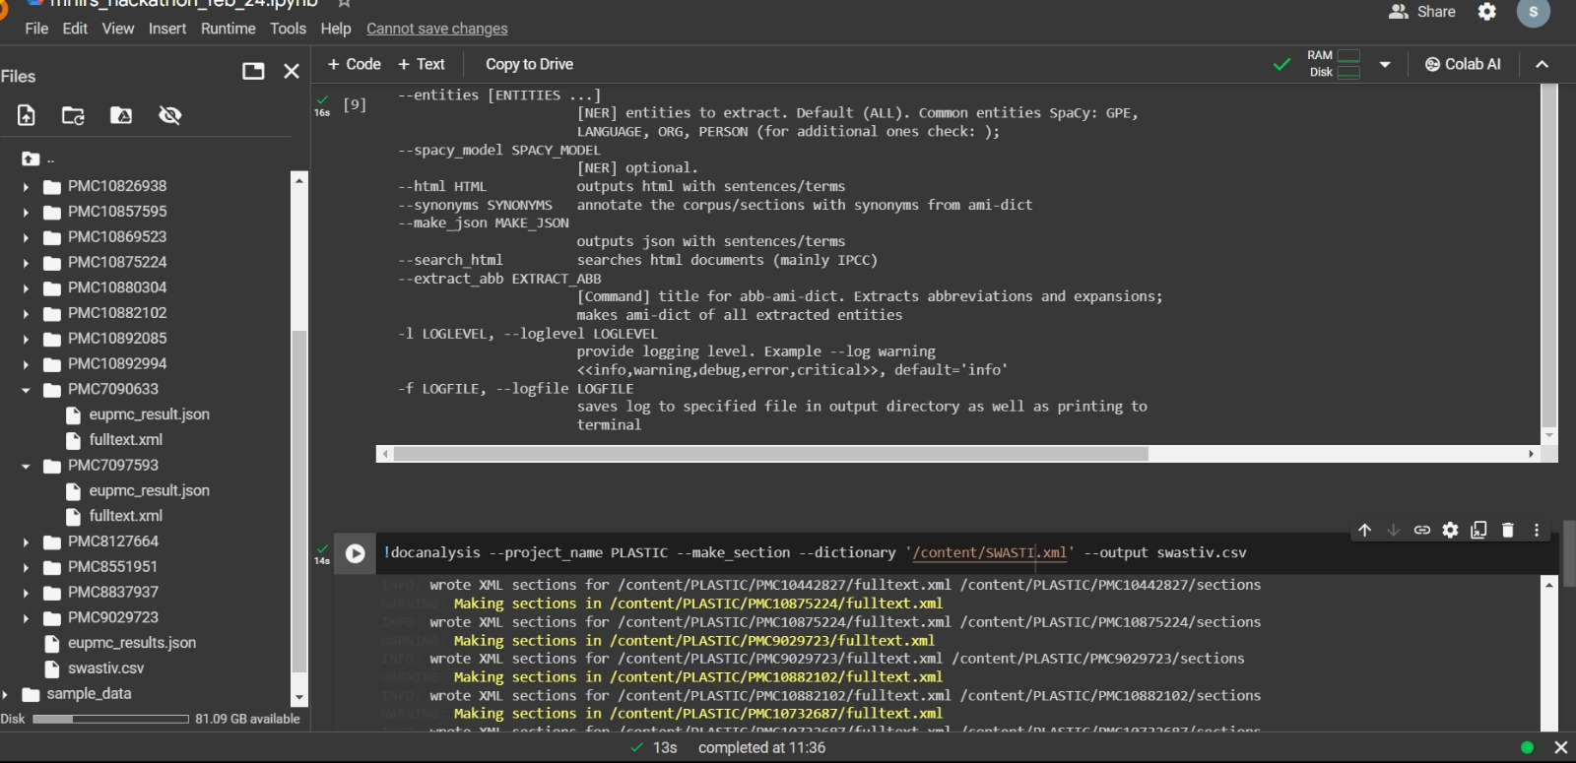

Slide 11
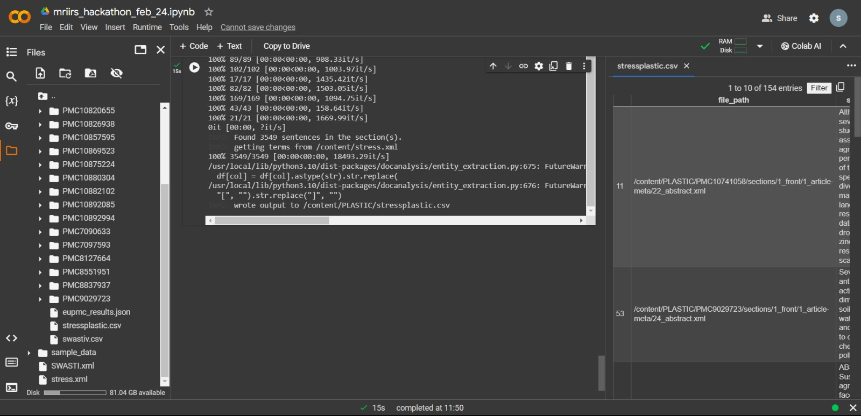

Slide 12
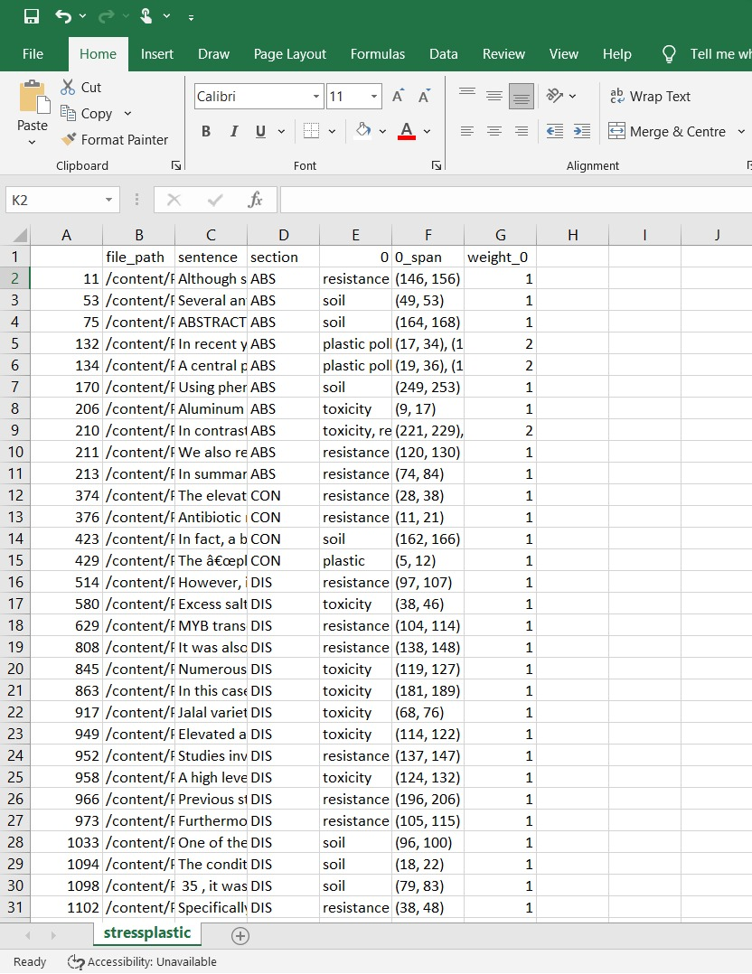
CSV FILE

Slide 13
SOLUTIONS
Stress-tolerant crops, coupled with AI or machine learning (ML) technologies to mitigate the impact of plastic and microplastic pollution on agricultural systems.
Identifying Plastic-Stress Tolerant Traits: AI and ML algorithms can analyze large datasets to identify genetic markers associated with stress tolerance in crops.
Optimizing Crop Management Practices
AI and ML algorithms can analyze environmental data, including soil composition, moisture levels, and plastic concentrations, to recommend optimal crop management practices. This includes adjusting irrigation schedules, fertilizer application rates, and crop rotation strategies to minimize the negative impact of plastic pollution on crop health and productivity.

Slide 14
Predicting Crop Responses to Plastic Pollution
AI and ML models can predict how different crop varieties will respond to plastic and microplastic pollution based on their genetic makeup and environmental conditions
This information can help farmers select the most suitable crops for planting in plastic-contaminated soils and anticipate potential yield losses or crop damage.
Enhancing Phytoremediation Efforts
AI and ML technologies can optimize phytoremediation strategies by identifying stress-tolerant crops with the ability to absorb and metabolize plastic pollutants.
By analyzing plant-microbe interactions and pollutant degradation pathways, researchers can engineer crops with enhanced phytoremediation capabilities, accelerating the cleanup of plastic-contaminated agricultural lands.

